Slide 1
Team Project Presentation
WTeam - Marc, Viktoria, Weronika, Dean, Javier, Nijin, Huseyin

Slide 2
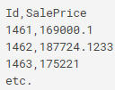
Starting Out
Project : House Prices
Objective
Create a model that predicts the sale price of houses from numerous variables that describe the features of the house.
The Basics
Team members are to constantly update progress on Jira.
Code is to be written on Google Colab,
Team members can get assistance from notebooks uploaded on Kaggle and other sources.
Modify code and attempt to get the best predictions possible.
Submission
Submission files are to be in .csv file format.
Submission should be styled as below with ID and SalePrice.

Slide 3
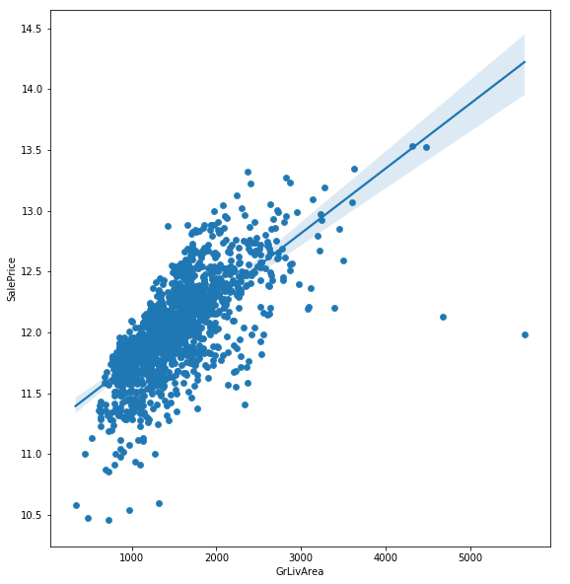
Regression
Helps investigate the relationship between two variables
Can be presented on a scatter graph and correlating line can be places through to show the constant.
Can also look at the relationship between predictors and your outcome.
For instance in the graph you can see that:
the sale price rises for houses where there is a lot of people living in the area
There is a correlation that can help us predict house prices as we can base it off there
But there are a couple outliers that will show the uniqueness of some of the properties

Slide 4
Types of regression
Linear regression:
One of the most common types of machine learning algorithms.
You can create a straight line between your outcome and predictor like a correlation.
Cons
Little predictive power as results in a high-variance, low bias model.
Lasso regression:
This additional term disciplines the model for having coefficients that do not explain a sufficient amount of variance in the data.
It also has a tendency to set the coefficients of the bad predictors mentioned above 0.
Cons
Lasso can also struggle with strongly correlated data in which it usually selects one predictor to represent the whole picture of the correlated predictors.
Ridge Regression:
sums the squares of coefficient values and multiplies it by some constant lambda.
Cons
it is capable of selecting more than n relevant predictors if necessary unlike Lasso. It will also select groups of collinear features, which its inventors dubbed the ‘grouping effect.’
Elastic net:
This gives us the benefits of both Lasso and Ridge regression.
It has been found to have predictive power better than Lasso, while still performing feature selection.

Slide 5
Outliers
-Outliers are the data that do not follow the pattern created via the correlation of the whole data.
-How to tackle the problems you come across;
Imputation,Capping,Crediction.

Slide 6
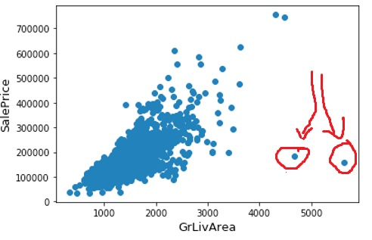
Outlier
-In order to make prediction you can use the following code to create the following scatter diagram from your data;
fig, ax = plt.subplots()
ax.scatter(x = train_df['GrLivArea'], y = train_df['SalePrice'])
plt.ylabel('SalePrice', fontsize=13)
plt.xlabel('GrLivArea', fontsize=13)
plt.show()

Slide 7
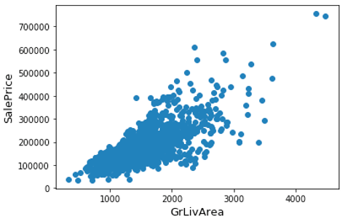
Outliers
-Best way is to get rid of the outliers which makes the outcome more accurate.
train_df = train_df.drop(train_df[(train_df['GrLivArea']>4000) & (train_df['SalePrice']<300000)].index).

Slide 8
Missing data
In python they are represented with (NaN), which means “Not a Number”.
3 reasons why it would happen:
Refusal to Provide Data.
Data not yet collected.
Inapplicable data element.
2 ways of dealing with missing values/data:
If the missing values in the column is equivalent to more than 50%, we should drop the columns because there is no point on rescuing the data.
If it is less than 50%, we can use an average to fill in the missing data. These can be based on data.

Slide 9
EDA
Purpose of EDA-
Getting familiar with the data itself by taking a look at different data attributes
Diving deep into the data to understand patterns or to confirm a hypothesis
It is need based triggered by a business event or a question
The process by analysts
Insight needed into a specific problem
Explore, segment and profile
Share results
Segmentation and Profiling
Segments are represented in groups of similar entities to analyze such as age group, gender, race and education.
Graphical tools
You plot your data on a graph to assess trends this is good for data that is too large to look at in table form.
Statistics
Descriptive statistics:
Help us understand the overall picture about the data by using an aggregated techniques or standard deviation which divides data into segments such as different house prices and per percentage of people who purchase it based on that price.

Slide 10
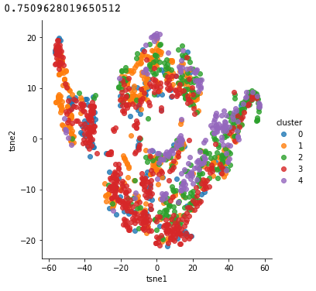
Cluster Sampling
Cluster sampling is a method used to see where clusters happen on a scatter graph, this is great for a few reasons :
Cluster sampling is great for identifying outliers
Its allows for you to see the pattern in the data
Clusters happen for a variety of reasons, so seeing the data will be helpful

Slide 11
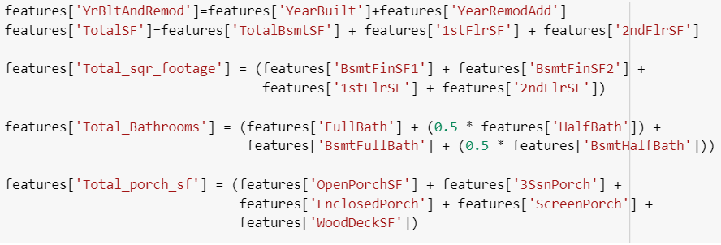

Slide 12
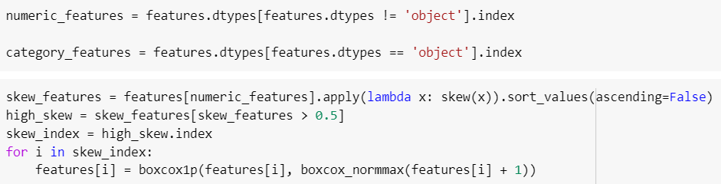

Slide 13
Categorical data The variable is considered categorical, when it describes some qualitative property and there is a limited number of option for its values.
Many Machine Learning algorithms need to convert categorical data into numerical data as they cannot handle categorical variables
High dimensionality means a matrix with many dimensions. High dimensionality requires many observations and often results in overfitting

Slide 14
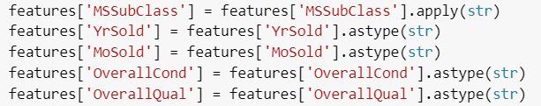
Approaches:
One-Hot Encoding
Hashing -Like OneHot but fewer dimensions, some info loss due to collisions.
Ordinal - convert string labels to integer values 1 through k (columns)
Binary- convert each integer to binary digits. Each binary digit gets one column. Some info loss but fewer dimensions
Label Encoding
The Bayesian

Slide 15
One-hot encoding
Problems:
This method creates new columns, it increases dimensionality of a data.

Slide 16
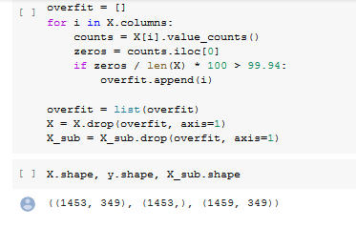
Removing Overfit
Overfitting happens when a feature is too closely fit to a limited set of data.
This modelling error can be fixed in a number of different ways but we chose to remove certain features
In our case, we removed columns where the threshold of zero's was greater than 99.94.

Slide 17
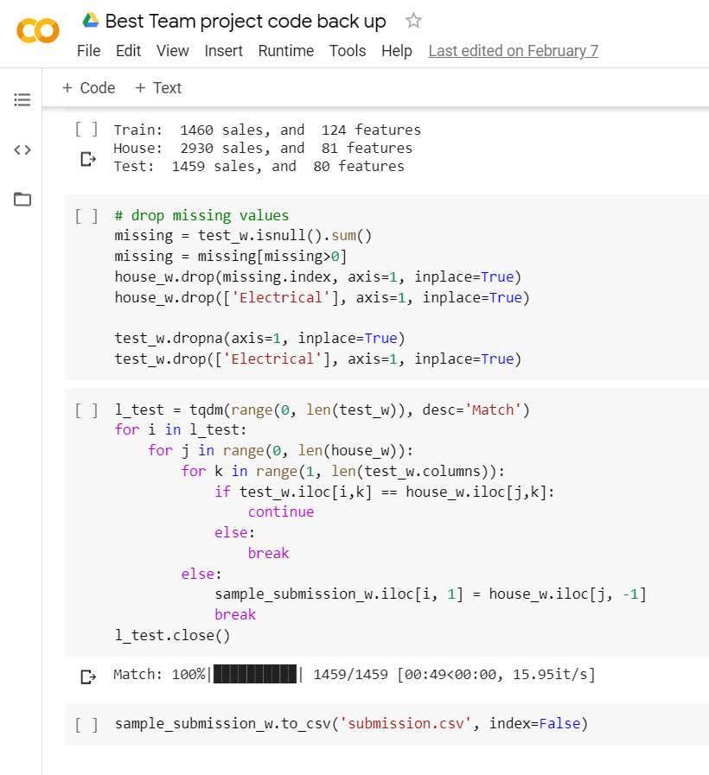
Submission (Highest Score)
One of the objectives of this project was to achieve the highest possible ranking on kaggle … so somehow we managed to achieved position 36.
However, this was achieved using a matching technique were we matched our submission scores to a perfect kaggle score submission in order to get our perfect submission score. We used a notebook to do this, with this technique you can get the highest kaggle score but there isn't any actual machines learning and functionality to it meaning its not correct.
The purpose of this code was not to have this as our final submission but to show everyone just how easy it is to achieve the highest score possible. This code is definitely not going to work in future house prices because it doesn't have any machine learning in it. This code's main purpose was to compare it to our other program and how even though this code scored higher, it doesn't necessarily make it better.

